Slide 1
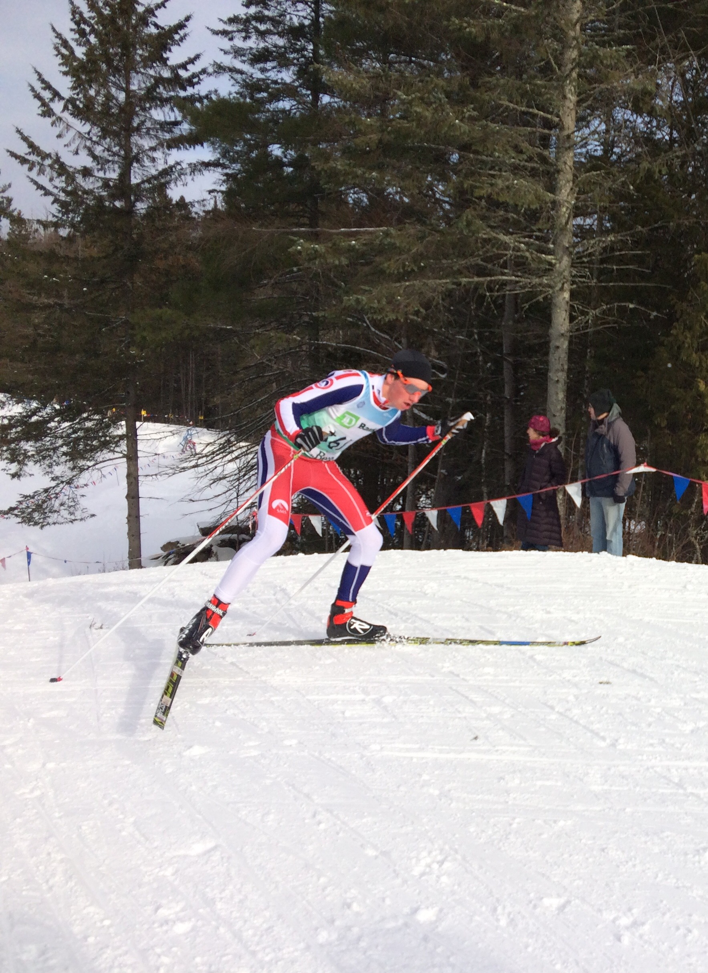
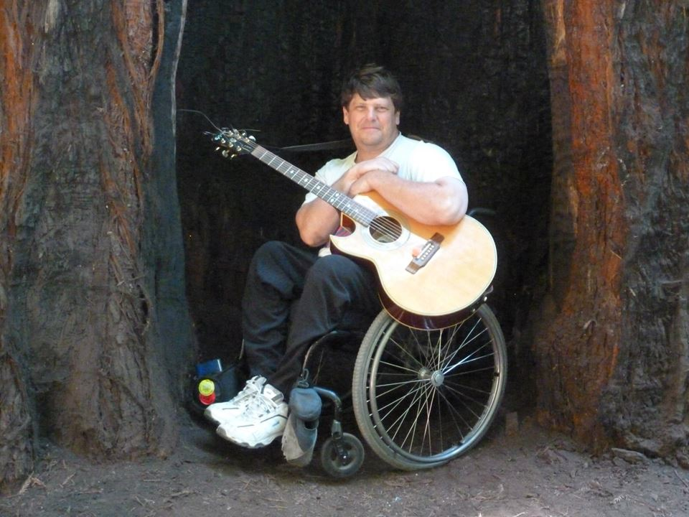
Breaking the barriers for Rehabilitation Medicine in Africa and Globally: the role of the International Rehabilitation Forum Andrew J. Haig, M.D. andyhaig@umich.edu
Pain, no nerve damage
Nerve damage, no pain

Slide 2
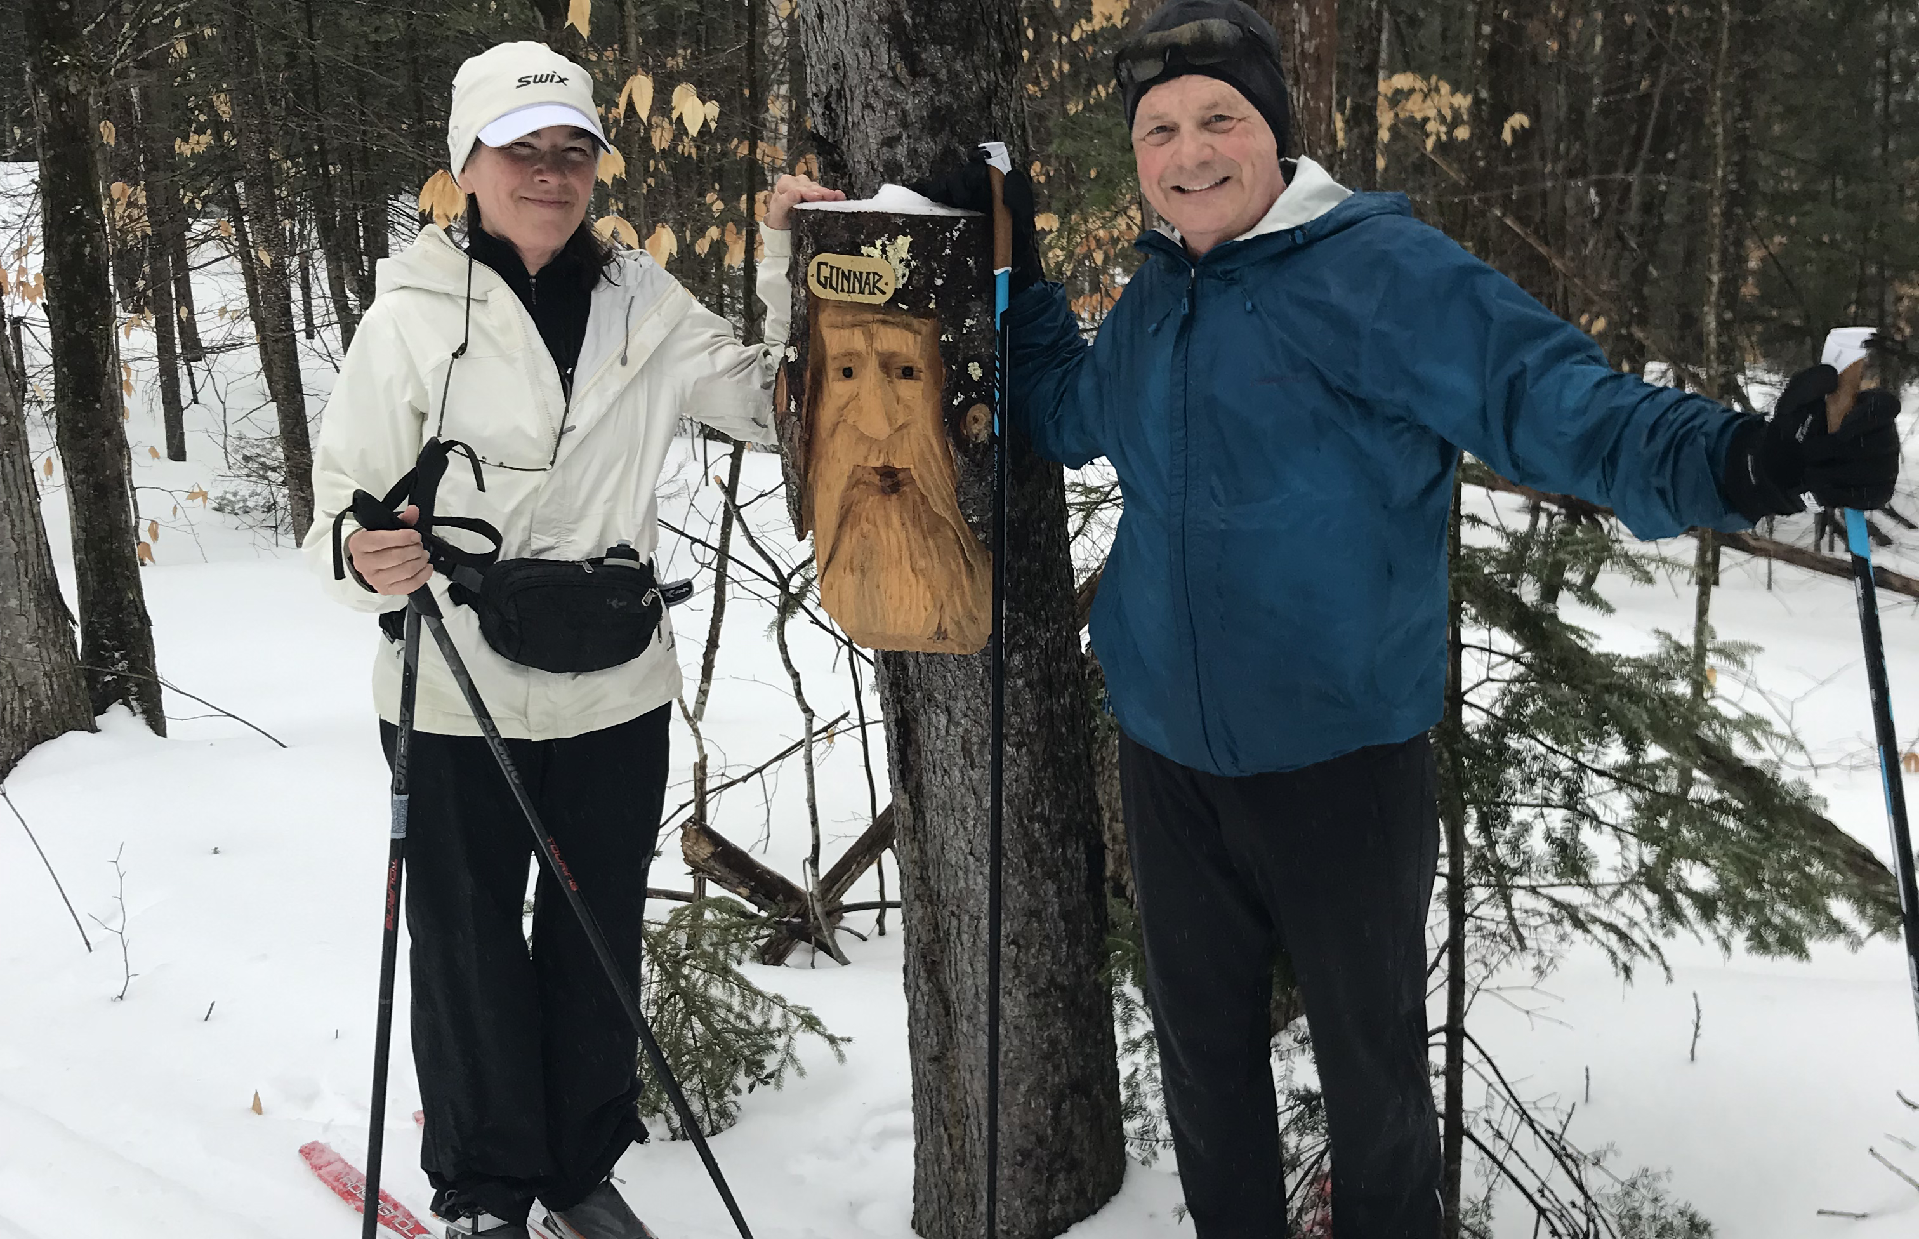
Disclosures:
Haig Consulting
Haig Physical Medicine
I’m a foreigner
I speak Cheezehead dialect
(from Wisconsin)
I’m emeritus professor at the University of Michigan.
(It’s the one shaped like a mitt)
Emeritus=demented
I live in touristy Vermont where it snows all winter.
Don’t come in July…sledding is not so good then
and all you can do is bike, swim and hike

Slide 3
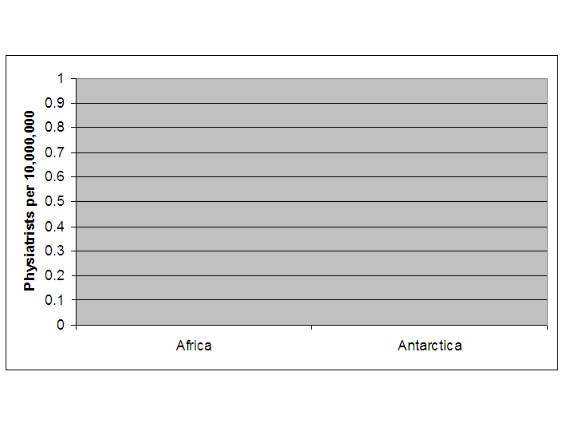

Here’s some research involving SA:

Slide 4
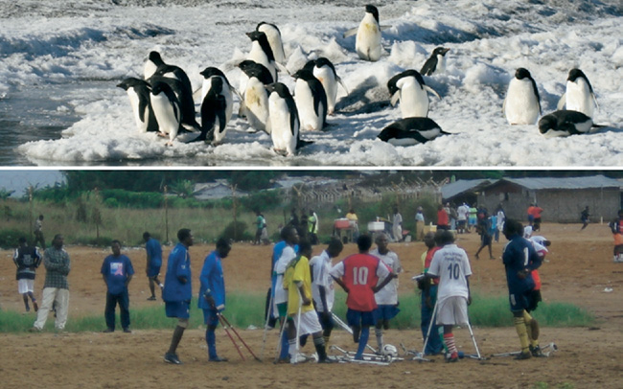
Figure 2: Above: Adelie penguin in Antarctica. Below: Homo sapiens in Africa. Both groups have a statistically similar chance of interacting with a physiatrist. Note that the penguins all have legs.

Slide 5
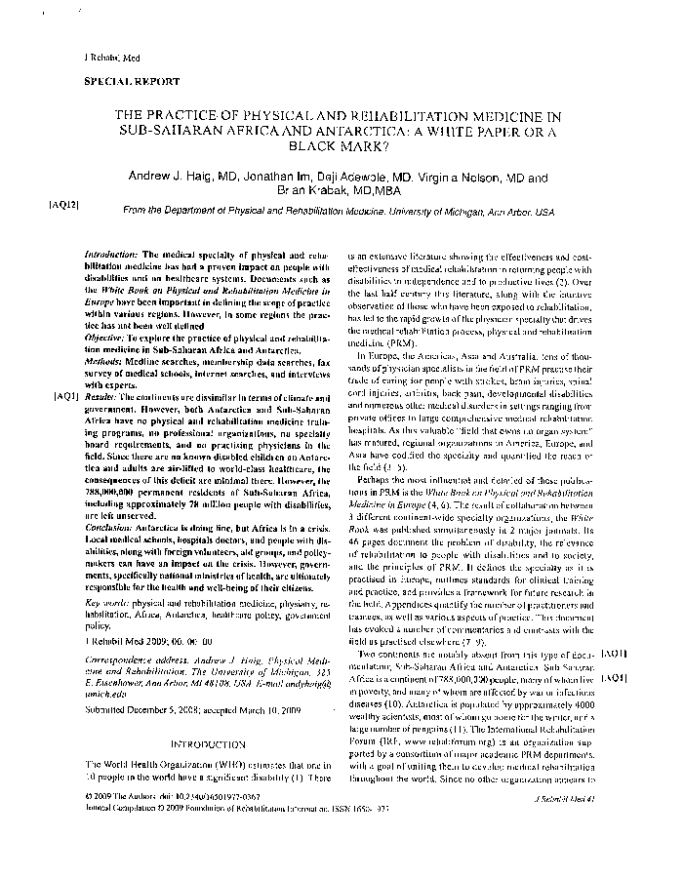
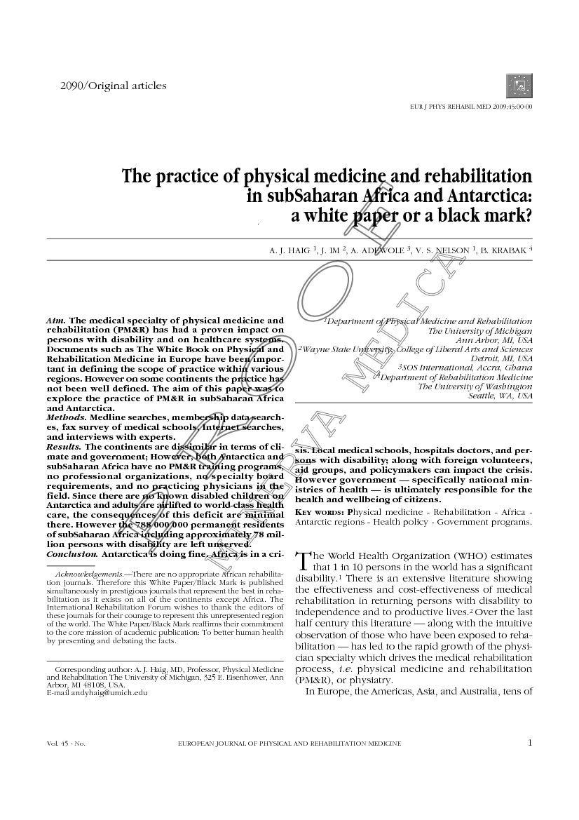
Why would a paper compare Africans to Penguins?
What is this specialty that created such a stir?
Now, a decade later, what is happening?

Slide 6
PM&R: A physician specialty focused on functioning
‘Surgeons use knives, internists use pills, Physiatrists use TEAMS”
Special training to lead and work with allied health teams
Orchestrate goals, time frames, persons responsible, quality
“discharge planning begins on the day of admission”
A dedicated, distinct inpatient rehabilitation ward or hospital
Consultation in acute hospitals; trauma wards
Long term outpatient management

Slide 7
Common PM&R consultation:
Inpatients
Spinal cord injury
Brain injury
Multitrauma
Amputation
Stroke
Neurological diseases
Polyarthritis
Burns
Outpatients
Back and neck pain
Nerve damage
Progressive nerve diseases
Sports injuries
Work disability
Cancer
Pediatric disabilities

Slide 8
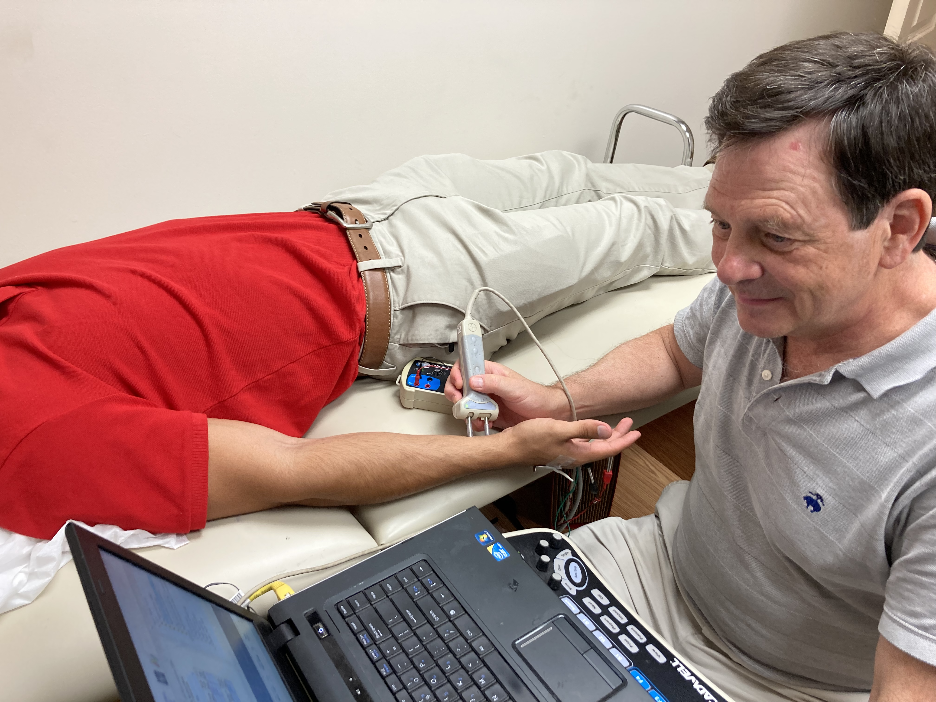
PM&R requires physician skills
Diagnostic expertise
Examination, labs, films
Specialized electromyographers, diagnostic injection skills
Treatment expertise
Drugs for bladder, bowel, clots, infections, bleeding, mental health, pain
Procedures for spasticity, pain, etc.
Serial casting, manual medicine other hands-on skills
A specific competency in rehab ‘diseases’
Surgeons, internists, neurologists typically sign off quickly

Slide 9
Overwhelming evidence of effectiveness
Since Halstead review 1970’s
Dozens of randomized controlled trials.
Outcomes with PM&R:
Less death
Less disability
Less unnecessary surgery
Less opioid use
shorter length of stay
less cost
better quality of life
Empirical evidence from health systems that simply can’t live without PM&R
Paul Clyde’s exploration of PM&R in Uganda
The need among wealthy Africans is so great that a fee-for-service PM&R program would support a charity hospital’s services.

Slide 10
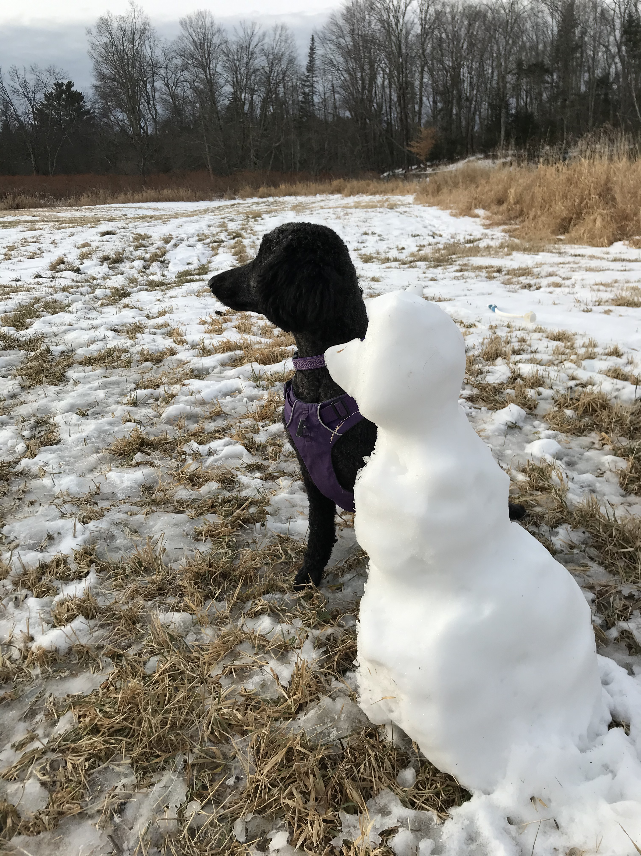
PM&R is the standard elsewhere
69 National societies are members of ISPRM
39,000 in China
12,000 in the United States
4000 in Italy
1200 in Mexico
1000 in Indonesia
200 in Bangladesh

Slide 11
What went wrong with PM&R in Africa?
Community Based Rehab? Similar idea as Community Based Brain Surgery
International aid organizations get money for helping, not creating jobs for clinicians
Different anatomically oriented specialists see rehab therapists as technicians.
Ministries of health, education, agriculture, employment, all pass the buck.
Conflict of interest: People with disability ‘in’ the communities don’t represent those in the trauma unit.

Slide 12
What is different in South Africa
Private and government inpatient rehabilitation centers providing good care.
Many self-trained doctors who become quite good at some limited part of inpatient rehabilitation
Gaps that interfere with their personal sophistication
Mostly not trained in outpatient pain, EMG, sports, spine, pediatric rehab
Little consultation in acute hospitals
No recognition of the specialty by government or employers
No academic program in rehabilitation medicine
Most medical students have no idea of this career path

Slide 13
The International Rehabilitation Forum www.rehabforum.org
15 year old not-for-profit organization dedicated to advancing rehabilitation throughout the world
We shine a light on what’s needed
We collaborate and are subservient
Subservient to YOU: We are a tool for you to use in your personal mission

Slide 14
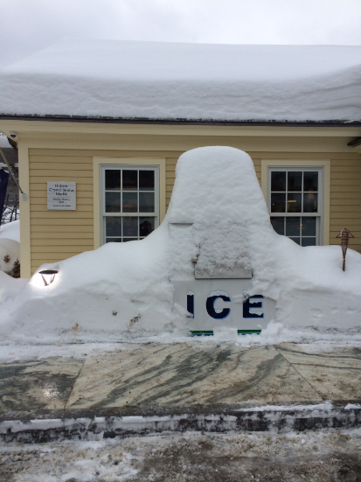
The IRF Africa Rehabilitation Fellowship
Years of groundwork with clinicians, administrators, and governments
NO money to the local hospitals
Extensive work with national Colleges of Physicians to legitimize the fellowship
Official board certification in Ghana and Ethiopia

Slide 15
Curriculum behind the curriculum:
Fighting the political and financial battles together
Preparing to be the national leaders
Preparing to be a unified African leadership
Rehab for Africa, not implanted American rehab

Slide 16
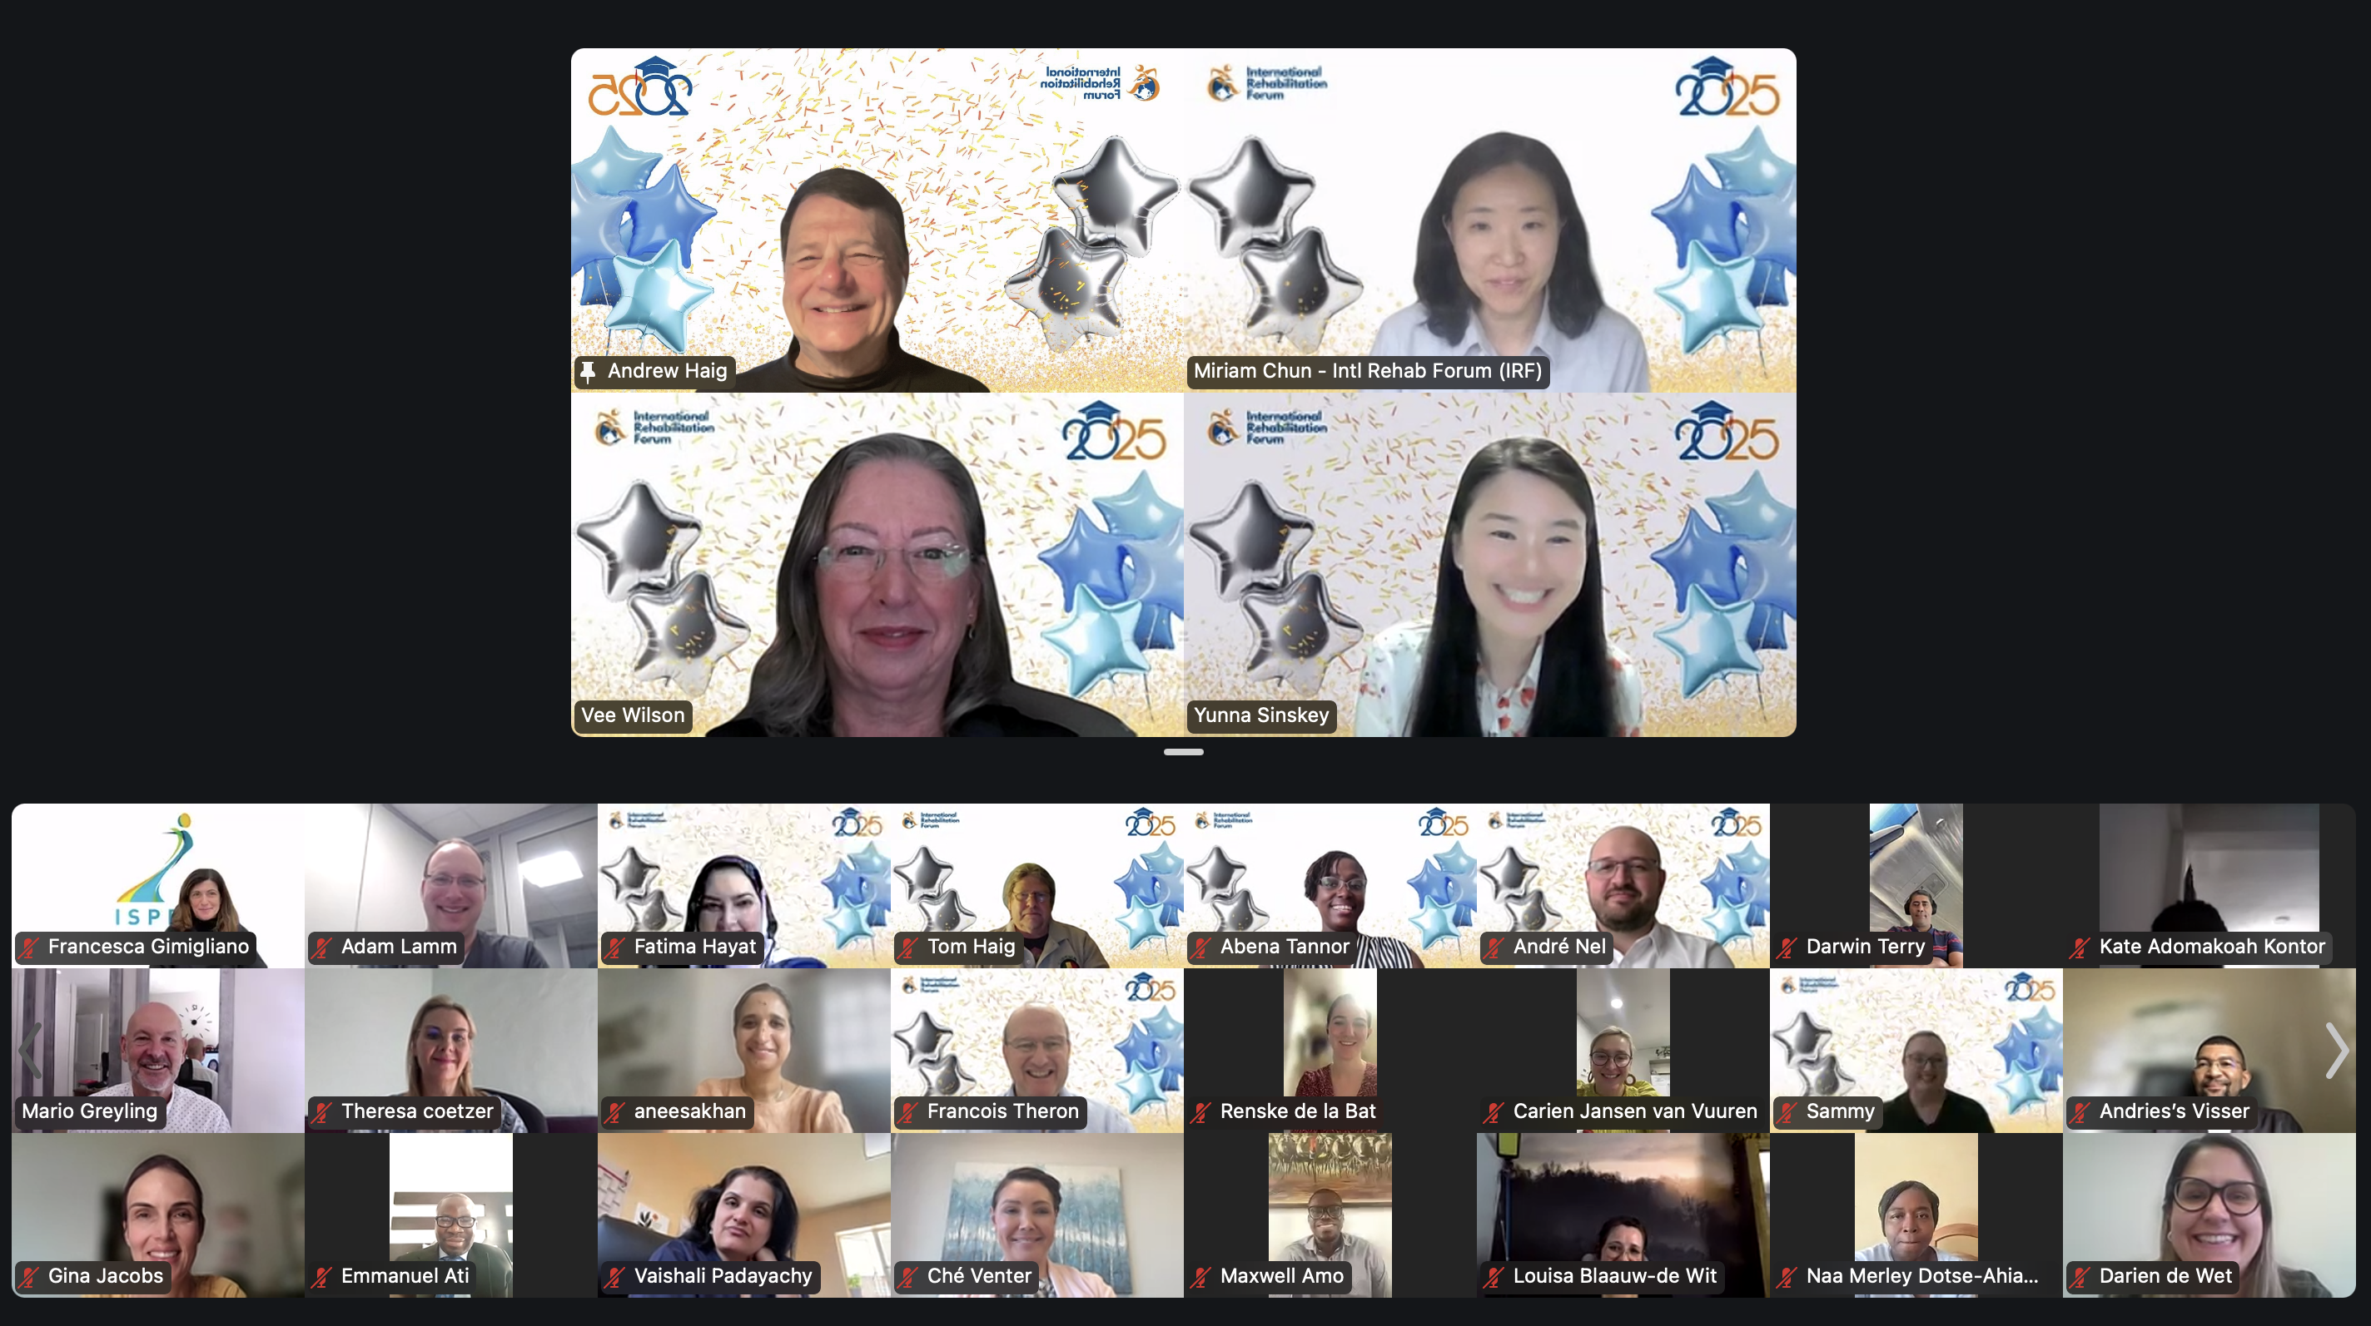

Slide 17
It is NOT AT ALL perfect
Hard to find faculty
Hard to get consistent homework from faculty
Hands on help is REALLY needed
Travel outside is REALLY needed
Western competency exams sometimes don’t fit African medicine
Next years fellows come from where?

Slide 18
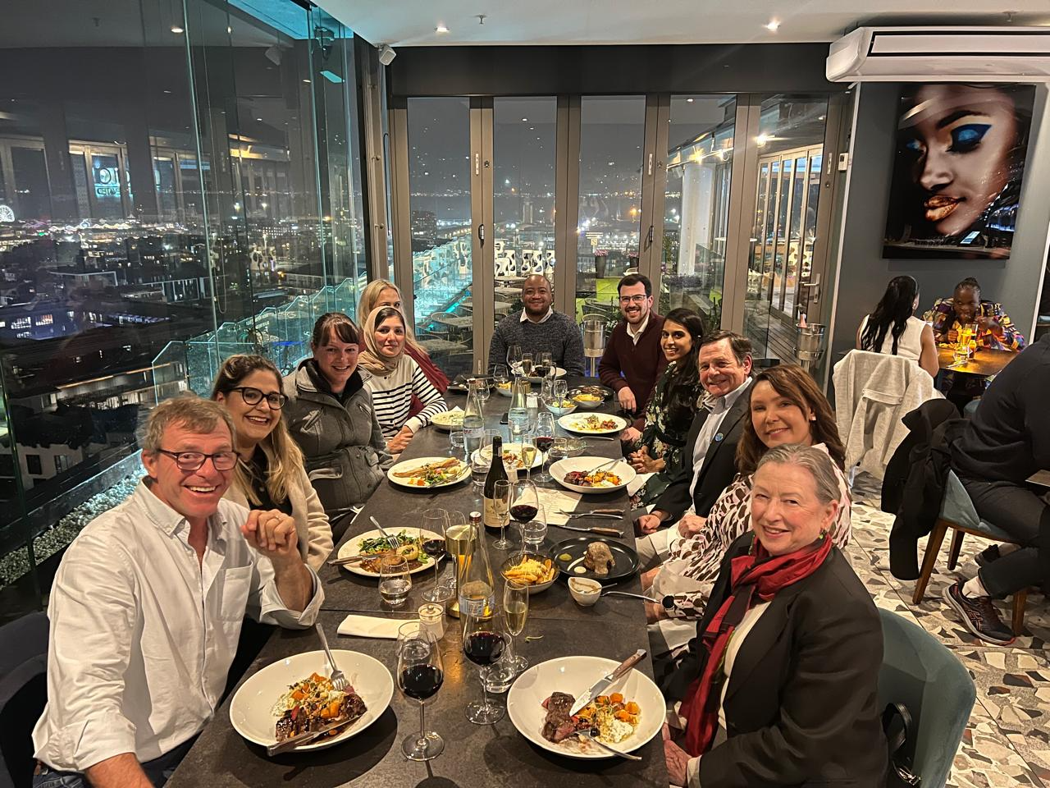
Yet there’s a future.
These fellows now have legitimacy to practice and be teachers in PRM. Give SA a decade and their students will be fully trained.
Their institutions have committed to a next phase
A number of doctors and institutions across Africa have contacted us to join in.

Slide 19
And there is scalability
Lectures are easy to scale
Case conferences probably easy
Each site must commit to:
A local faculty mentor
An ongoing program-not just one interested person
Redesign of clinical processes towards a rehab team and an inpatient ward
An outside fully trained PRM mentor
The ISPRM now supports us; we help lead the WHO’s World Rehabilitation Alliance

Slide 20
Finally…SA’s leadership of Africa
Institutional ranking for research productivity ‘about’ Africa
University of Ghana is rated #47
Ahead of that:
14 South African Universities
33 non-African institutions.
You are the thought leaders for 850 million people
*Scholar GPS, May 2025

Slide 21
Thank You South Africa!
Mario Greyling and Nurture Health
Vee Wilson, Francois Theron and the IRF’s Physical Medicine and Rehabilitation Fellows from all over SA
ISCOS and my new South African friends!

